Slide 1
INTRODUCTION

Slide 2
HTML
HTML is the standard markup language for Web pages.
A markup language is a set of rules that defines how the layout and presentation of text and images should appear in a digital document.
It allows structuring documents, adding formatting, and specifying how different elements should be displayed (or “rendered”) on webpages.
With HTML you can create your own Website.

Slide 3
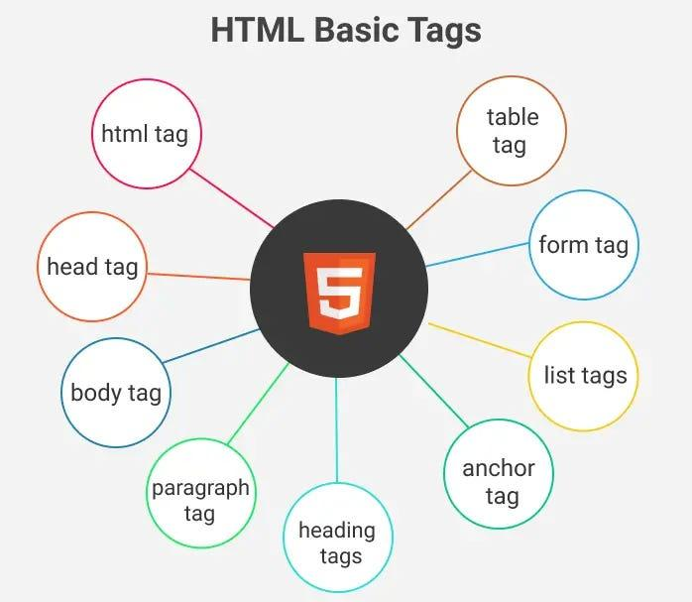

Slide 4

SAMPLE CODE:
<!DOCTYPE html>
<html>
<head>
<title>Page Title</title>
</head>
<body>
<h1>My First Heading</h1>
<p>My first paragraph.</p>
</body>
</html>
Output:

Slide 5
TABLE TAGS:
<!DOCTYPE html>
<html>
<head>
<style>
table, th, td {
border: 1px solid black;
}
</style>
</head>
<body>
<h1>The table element</h1>
<table>
<tr>
<th>Month</th>
<th>Savings</th>
</tr>
<tr>
<td>January</td>
<td>$100</td>
</tr>
<tr>
<td>February</td>
<td>$80</td>
</tr>
</table>
</body>
</html>

Slide 6
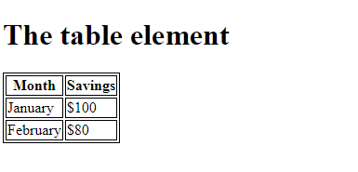

Slide 7
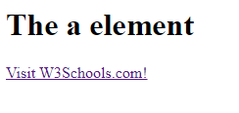
ANCHOR TAGS:
<!DOCTYPE html>
<html>
<body>
<h1>The a element</h1>
<a href="https://www.w3schools.com">Visit W3Schools.com!</a>
</body>
</html>

Slide 8
FORM TAGS:
<!DOCTYPE html>
<html>
<body>
<h1>The form element</h1>
<form action="/action_page.php">
<label for="fname">First name:</label>
<input type="text" id="fname" name="fname"><br><br>
<label for="lname">Last name:</label>
<input type="text" id="lname" name="lname"><br><br>
<input type="submit" value="Submit">
</form>
<p>Click the "Submit" button and the form-data will be sent to a page on the
server called "action_page.php".</p>
</body>
</html>

Slide 9
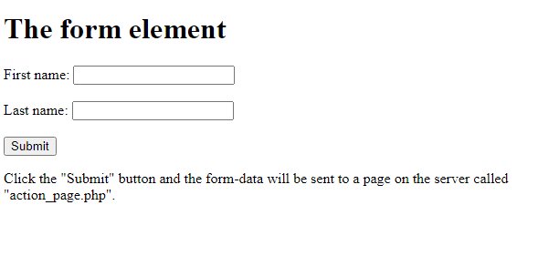

Slide 10
LIST TAGS:
<!DOCTYPE html>
<html>
<body>
<h2>An Unordered HTML List</h2>
<ul>
<li>Coffee</li>
<li>Tea</li>
<li>Milk</li>
</ul>
<h2>An Ordered HTML List</h2>
<ol>
<li>Coffee</li>
<li>Tea</li>
<li>Milk</li>
</ol>
</body>
</html>

Slide 11
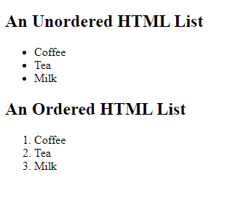

Slide 12
CSS (Cascading Style Sheet)
CSS is the language we use to style an HTML document.
CSS describes how HTML elements should be displayed.
SAMPLE CODE:
<!DOCTYPE html>
<html>
<head>
<style>
body {
background-color: lightblue;
}
h1 {
color: white;
text-align: center;
}

Slide 13
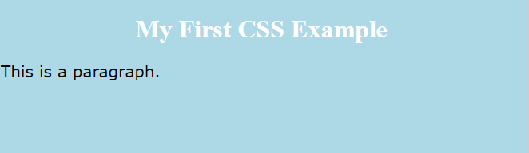
p { font-family: verdana; font-size: 20px; } </style> </head> <body> <h1>My First CSS Example</h1> <p>This is a paragraph.</p> </body> </html> OUTPUT:

Slide 14
JAVASCRIPT:
JavaScript is the world's most popular programming language.
JavaScript is the programming language of the Web.
Javascript to program the behavior of web page.
JavaScript is easy to learn.
SAMPLE CODE:
<!DOCTYPE html>
<html>
<body>
<h2>My First JavaScript</h2>
<button type="button"
onclick="document.getElementById('demo').innerHTML = Date()">
Click me to display Date and Time.</button>

Slide 15

<p id="demo"></p>
</body>
</html>
OUTPUT:
My First JavaScript
Mon Jan 22 2024 09:46:53 GMT+0530 (India Standard Time)

